Slide 1
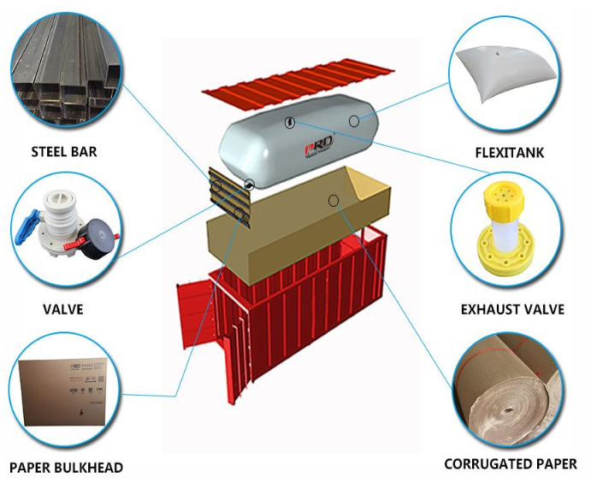
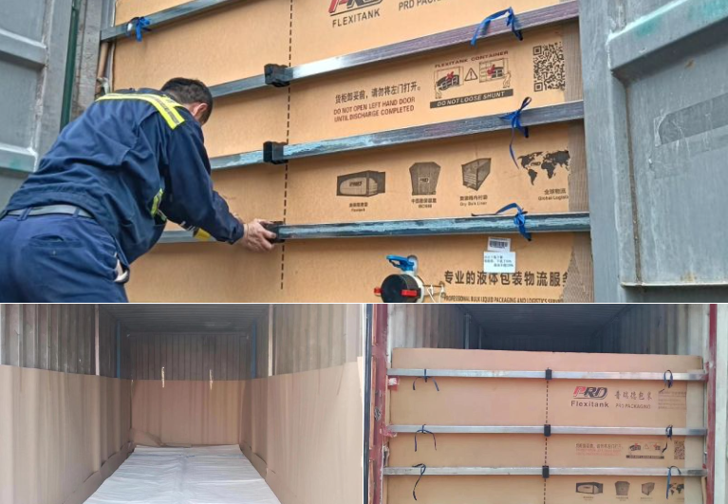
Flexitank - Bulk Liquid Transportation & Solutions
Flexitank - Bulk Liquid Transportation & Solutions
FleFlexitank - Bulk Liquid Transportation &
xitank - Bulk Liquid Transportation & Solutions
Flexitank - Bulk Liquid Transportation & Solutions
* Our Flexitank is suitable for storage & transportation of non hazardous liquid products (food & non food). The flexitank enables you, to convert a standard 20ft ISO container into a liquid container. The cubic capacity ranges up from 16.000 to 24.000 litres.
* Made from patented polyethylene films, our Multilayer Flexitank exhibits excellent resistance to stress cracking and giving the Flexitank a robust structure to withstand the hars sea/ road/ rail conditions. The individual polyethylene film is highly flexible and elastic. Combined with a unique sealing technique the multilayer of polyethylene films work together like a single body which will provide a maximum discharge. The Multilayer is the best selling Flexitank . Through consistent research and customer’s feedback, our company continues to improve the design of the multilayer Flexitank. To date, we have been thousands of successful commercial loads each month and this number continues to grow rapidly.

